Slide 1
DNSSEC and the Web
How to improve security and reliability for the Web with DNSSEC
| John Franklin, 17 August 2024

Slide 2
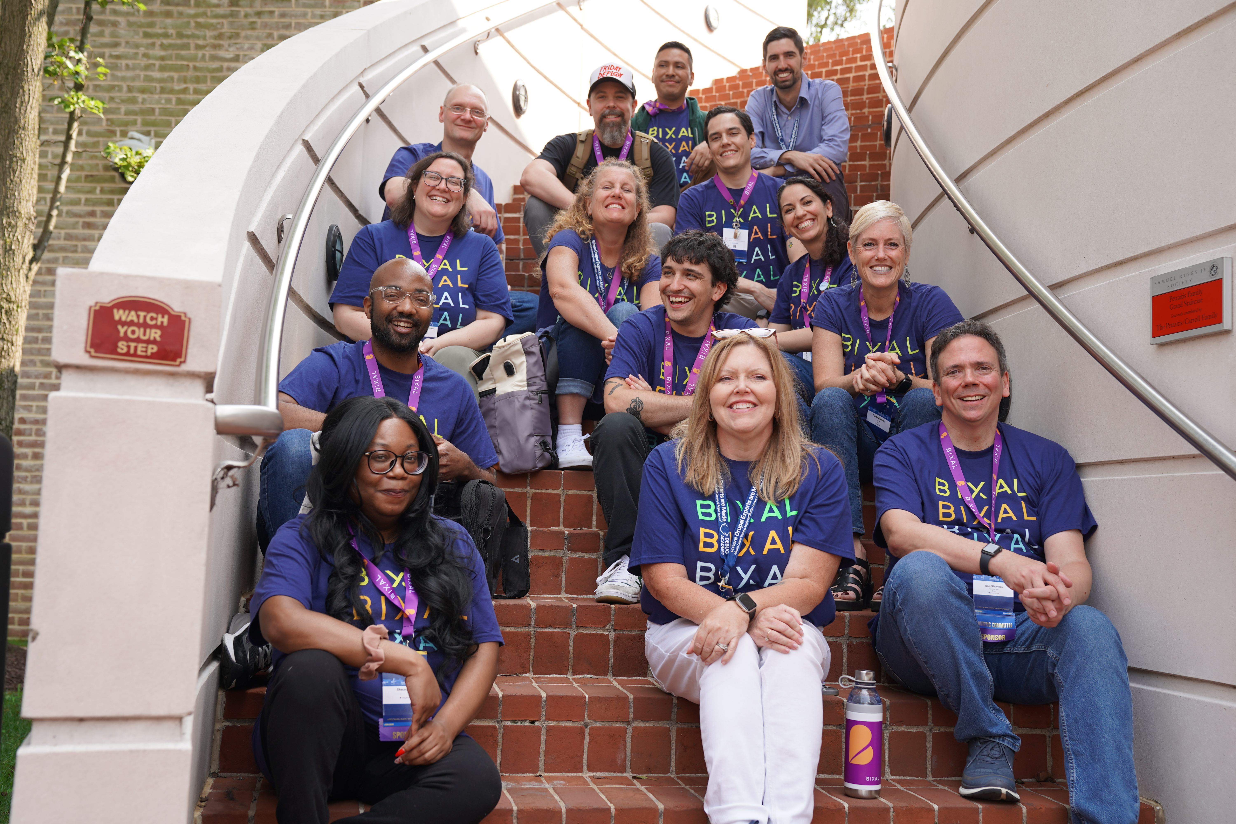

We are Bixal
jobs.lever.co/bixal

Slide 3
DNS: How does it work?
Query / Answer
Q: www.bixal.com. A?
A: www.bixal.com. => CNAME d2id3snkxmh9hv.cloudfront.net.
Server Types
Forwarding resolver – passes the query on to another resolver.
Recursive resolver – performs multiple lookups to find the answer.
Authoritative server – serves the resources records for one or more zones.
Notes:
Zone = collection of DNS records under a common name. Bixal.com has a zone.

Slide 4
DNS Nomenclature
Domain – A namespace, e.g., bixal.com or com.
Zones – A collection of Resource Records (RRs) under a common domain.
Resource Records – Individual records in a zone.
www IN A 1.2.3.4
bixal.com. IN MX 10 mx.bixal.com.
Root zone – The zone for the root domain “.” (dot)

Slide 5
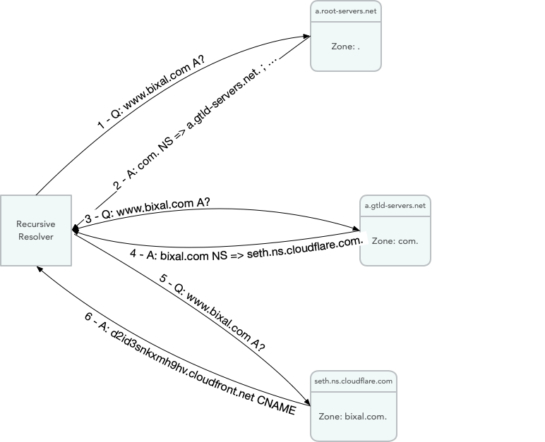
DNS: Recursive Resolvers
Q: @a.root-servers.net. www.bixal.com. A?
A: com. NS a.gtld-servers.net.
Q: @a.gtld-servers.net. www.bixal.com. A?
A: bixal.com. NS seth.ns.cloudflare.com.
Q: @seth.ns.cloudflare.com. www.bixal.com A?
A: www.bixal.com. CNAME d2id3snkxmh9hv.cloudfront.net.

Slide 6
DNS Resource Records (RRs)
SOA – Start of Authority
NS – Name Server
A – IPv4 address
AAAA – IPv6 address
TXT – Text (free form)
MX – Mail Exchange (where to send emails for a domain)
CNAME – Canonical Name

Slide 7
DNS Overview
Built to be a global, distributed lookup engine.
Because hosts.txt didn’t scale. (No shock there.)
Security? Why? It’s public data!
Three Pillars of Security:
Confidentiality – only those with permission can read the data.
Integrity – only those with permission can create the data.
Availability – what good is data you can’t access?
Notes:
First four network hosts: Stanford Research Institute (SRI), UCLA, UC Santa Barbara, U of Utah; 30 institutions by 1973. First DNS RFC: https://datatracker.ietf.org/doc/html/rfc1034 (November 1987)

Slide 8
DNS: A Problem of Integrity
In 2008, Dan Kaminsky discovered a cache poisoning attack.
Attackers could change the IP addresses returned for a hostname.
The “fix” doesn’t fix it, just makes it 65k times more difficult.
Need a way to verify the integrity of data returned.
Digital signatures!
RFC 4033 describing DNSSEC was published in March 2005.
Notes:
2008: .com = 77.5M, .net 11.8M, .org 7.2M
2021: .com = 157.0M, .tk 24.7M, .cn 20.7M, .de17M, .net 13.6M, .uk 11.0M, .org 10.4M

Slide 9
Encryption & Digital Signatures

Slide 10
Encryption 101
Symmetric encryption
Same key encrypts and decrypts.
Fast – Modern CPUs include extensions to support AES.
Asymmetric encryption
Requires a key pair.
Anything encrypted with one can ONLY be decrypted with the other.
Designate one “private”, and one “public”.
Digital signature
Create a checksum of the data, encrypt with the private key.
Receiver creates same checksum, compares with encrypted copy.
Notes:
Asymmetric encryption = Public key cryptography. SSL certs, ssh keys, pgp keys, all are public key crypto

Slide 11
DNSSEC
Add digital signatures to the RRs.
Publish public keys as their own RR.
Adds new RRs
RRSIG – Resource Record signature
DNSKEY – Public signing key for a zone.
DS – Delegation signer, a hash of the DNSKEY (KSK).
NSEC/NSEC3 – “Next SECure” records (proves non-existence of RRs)

Slide 12
DNSSEC Queries
Q: @ns.bixal.com www.bixal.com. A?
A:
www.bixal.com. CNAME d2id3snkxmh9hv.cloudfront.net.
www.bixal.com. RRSIG CNAME 13 3 bixal.com. fsgSbrY5DrPbZsC2UzC9sDdnmSFYBy1qKDnQCuTJFcglqfBHFRX8AXtF 7+PIekHk0qTdJRfOQqpogLk1E5bW7Q==

Slide 13
Why do I care?
Cache poisoning attacks redirect users before you see them.
Hard to detect!
Federal government is working to enable DNSSEC across .gov.
https://fedv6-deployment.antd.nist.gov/cgi-bin/generate-gov
If your DNS provider supports DNSSEC, deployment is trivial.
If they don’t, consider changing DNS providers. Seriously.
Improved infrastructure security and website performance.
Wait, what? Web site performance?
Notes:
2008 OMB memo M-08-23 mandated DNSSEC for .gov domains. 2018 OMB memo M-18-23 ”rescinded” it, while also saying, "agencies already should have implemented these security protections.“

Slide 14
Secure DNS Resources

Slide 15
SVCB and HTTPS RRs
SVCB – Service Binding
IETF Internet-Draft
Define service aliases or service parameters.
Provide server ECHConfigList for ECH (Encrypted Hello) messages.
HTTPS – SVCB specifically for HTTPS
$ORIGIN bixal.com
@ HTTPS 0 d2id3snkxmh9hv.cloudfront.net.
$ORIGIN cloudfront.net.
d2id3snkxmh9hv HTTPS 1 . alpn=h2,h3 ech="abc..." port=8443
d2id3snkxmh9hv HTTPS 2 d2id3snkxmh9hv-legacy alpn=http/1.1 port=443
Notes:
https://datatracker.ietf.org/doc/html/draft-ietf-dnsop-svcb-https
ALPN = Application Layer Protocol Negotiation

Slide 16
DANE
DNS Authentication of Named Entities
Leverages the DNSSEC trust to extend to system certs and keys.
TLSA – Define the cert or CA cert for the host.
Prevent forged SSL certs
SSHFP – SSH Fingerprint
SMIMEA – S/MIME certificate for email address.

Slide 17
DANE – TLSA
Defines:
a cert that is used for a service OR
a cert that signs the end cert.
Usable for any service that uses TLS.
Signals mandatory TLS usage, like HSTS.
Examples:
_143._tcp.mail TLSA [cert]
_22._tcp.jump-proxy TLSA [cert]
Notes:
HSTS preload

Slide 18
DANE – SSHFP
Defines the host SSH Fingerprint
No more TOFU!
Create with ssh-keygen –r <hostname>
jump-proxy IN SSHFP 1 1 81dd539758c46c2dd8efdaa8c1499c3deac820a3

Slide 19
DANE – SMIMEA
Defines the S/MIME certificate for an email address.
“hostname” is partial sha256 for user name.
Pros: can publish S/MIME certs
Cons:
Can easily determine valid email addresses
Email address becomes case-sensitive
C93f1e…1c1afd6._smimecert.bixal.com. SMIMEA [cert]

Slide 20
DNSSEC
What can it do for you?
Better ensure users get to your site.
Alias the apex of your domain to a load balancer.
With emerging protocols (http/2, quic), make the connections faster.
Better secure the ops infrastructure hosting your site.

Slide 21
Go forth and secure!

